Slide 1

Department of Computer Science & Engineering Course Title: Digital Logic Design Course Code: CSE-203 Section: DA Presentation On : Flip-Flops
Presentation By:
Md. Shipon Miah (213902104)
Md. Robin Hossian (213902105)
Md. Sohanur Rahman (213902106)
Presentation To:
Farhana Akter Sunny
Lecturer of CSE
Department of CSE, GUB

Slide 2
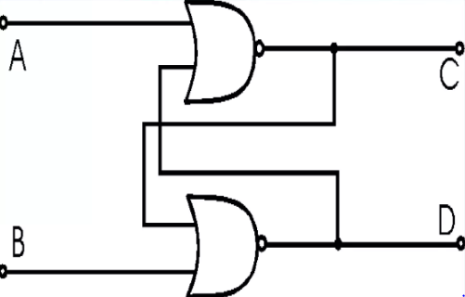
Flip-Flop
Electronic Circuit
Bi- Stable multivibrator
Sequential Logic
Store State Information

Slide 3
Types of Flip-Flops
SR Flip-Flop
JK Flip-Flop
T Flip-Flop
D Flip-Flop

Slide 4
The Used of Flip-Flop
For Memory Circuit
For Logic Control Devices
For Counter Devices
For Register Devices

Slide 5
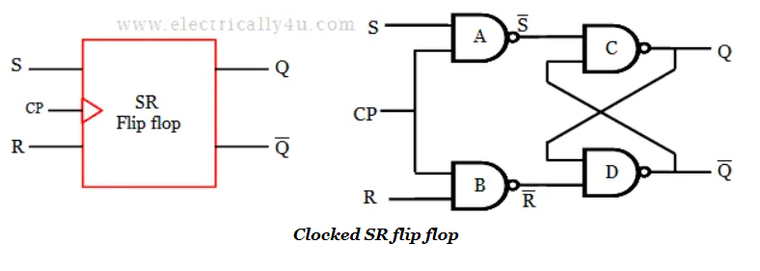
SR Flip-Flop
The SR flip flop is a 1-bit memory bistable
device having two inputs, i.e., SET and RESET.
The SET input 'S' set the device or produce the
output 1, and the RESET input 'R' reset the
device or produce the output 0.
The SET and RESET inputs are
labeled as S and R, respectively.

Slide 6
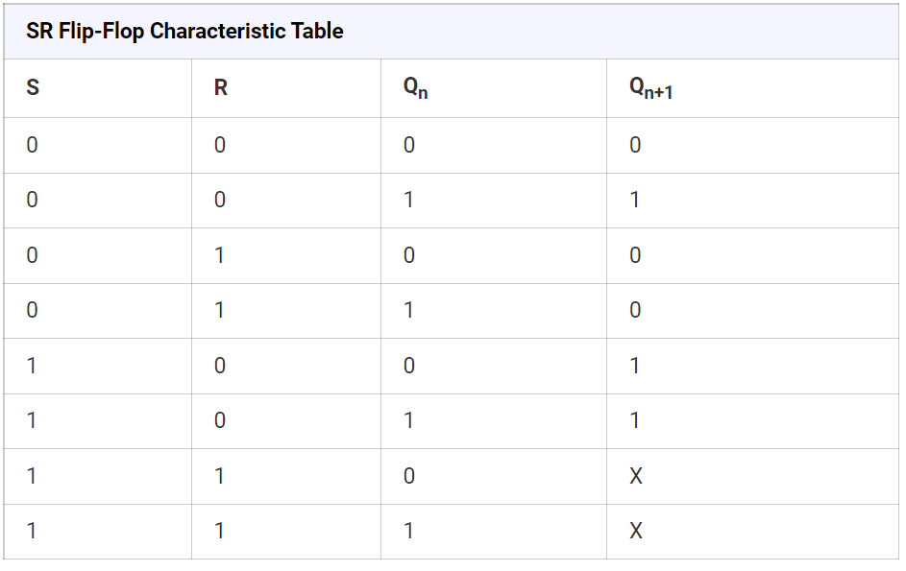
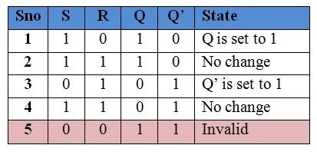
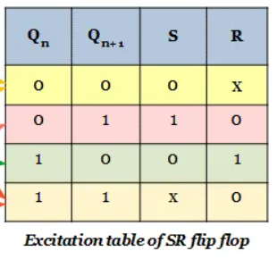
SR Flip-Flop

Slide 7
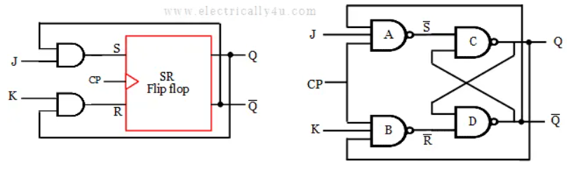
JK Flip-Flop
The JK Flip Flop is the most widely
used flip flop. It is considered to be a
universal flip-flop circuit. The
sequential operation of the JK Flip
Flop is the same as for the RS flip-flop
with the same SET and RESET input

Slide 8
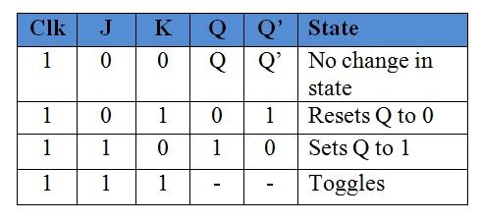
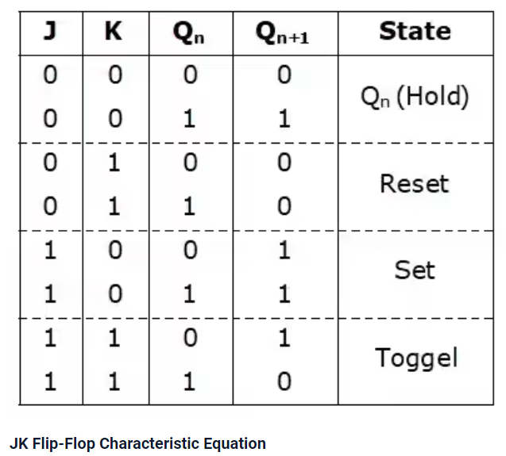
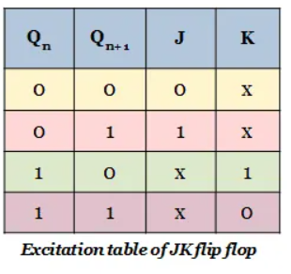
JK Flip-Flop

Slide 9
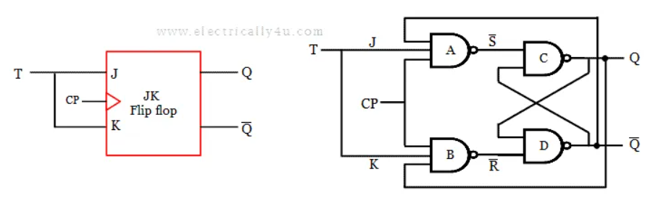
T Flip-Flop
A T flip flop is known as a toggle flip flop because
of its toggling operation.
It is a modified form of the JK flip flop.

Slide 10
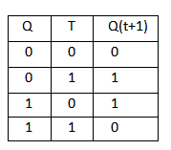
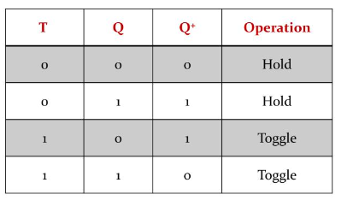
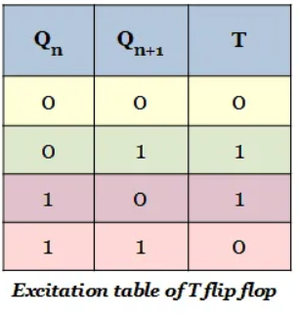
T Flip-Flop

Slide 11
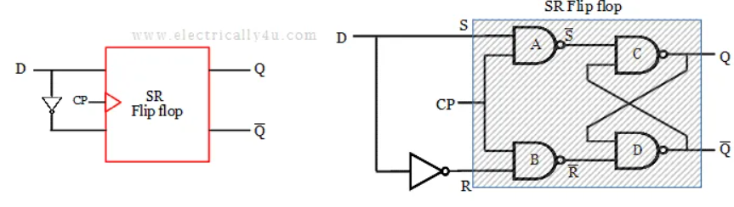
D Flip-Flop
The D flip-flop is a clocked with a single
digital input ‘D’. Each time a D flip-flop
is clocked, its output follows the state
of ‘D’. The D Flip Flop has only two
inputs D and CP.

Slide 12
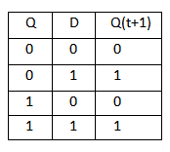
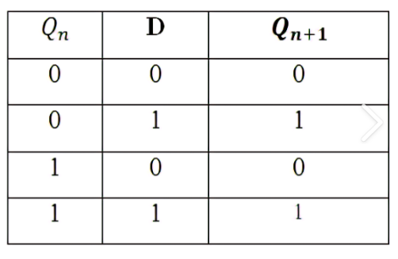
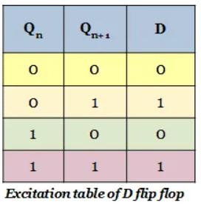
D Flip-Flop

Slide 13
Thank You

